Slide 1
Third-Party Web APIs
Introduction | Weather API | Cross-Origin Request | Calling The Weather API From JavaScript
Notes:
Welcome to our lecture on third part web APIs. In this lecture we will go through introduction to web APIs, reasons to use API, restful API, cross-origin requests, and how to call weather API in JavaScript. Let’s start the video lecture.

Slide 2

Introduction
Public web APIs allow access to an organization's data or user data stored by the organization, like Google Maps and Instagram APIs.
Thousands of free public APIs are available on platforms like GitHub.com.
Third-party web APIs enable web applications to access data from external organizations, facilitating integration with social media, maps, weather, and other data collections.
Notes:
Public web APIs allow access to data from organizations like Google Maps and Instagram. There are thousands of free public APIs available on platforms like GitHub. Third-party web APIs enable web applications to access external data for integration with social media, maps, weather, and other data sources, enhancing the functionality and user experience of websites.

Slide 3
Reason To Use APIs
Third parties require API keys for several reasons:
The API key identifies who or what application is using the web API.
The API key helps the third party limit the number of requests made to the API in a fixed third-party or may be used to charge a developer a fee for additional requests.
To obtain an API key, developers must agree to restrictions the third-party places on data obtained from the web API.
Notes:
To begin, API keys identify who is using the web API. Additionally, they help third parties limit the number of requests or charge fees for extra usage. Finally, developers must agree to the third party's restrictions when obtaining an API key. These controls help secure and manage access to valuable data and resources.

Slide 4
RESTful API
Most third-party web APIs are RESTful, using URLs with parameters to return data in JSON or XML format.
Example: http://linkedin.com/api/article?id=123 retrieves article ID 123 as JSON.
Web APIs can be called from either the web server or browser; this material focuses on using JavaScript in the browser.
Notes:
To summarize, most third-party web APIs are RESTful, using URLs with parameters to return data in JSON or XML format. For example, LinkedIn's API can retrieve an article by its ID as JSON. Additionally, APIs can be called from either the web server or the browser. In this course, we will focus on calling APIs using JavaScript in the browser.

Slide 5
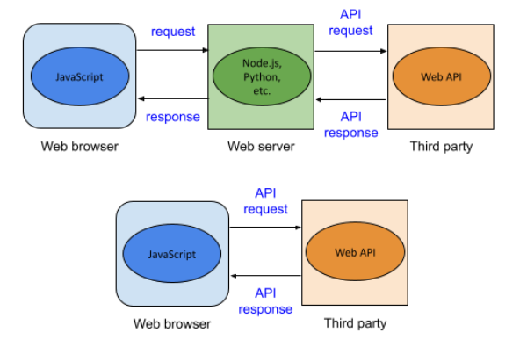
Example
Notes:
In this example, a web browser can call a third-party API in two ways. First, it can send a request to a web server, which then communicates with the API and returns the response. Alternatively, the browser's JavaScript can directly call the API, receiving the response immediately. Both methods enable dynamic data integration from external sources.

Slide 6
Weather API
OpenWeatherMap offers a free Weather API for current weather, forecasts, and historical data, requiring developers to register for an API key.
The API uses GET requests with query string parameters, detailed in the documentation on openweathermap.org.
Key parameters include zip (US ZIP code), units (standard, metric, or imperial), and appid (developer's API key).
Notes:
To explain, OpenWeatherMap provides a free Weather API for current weather, forecasts, and historical data. Developers need to register for an API key. Additionally, the API uses GET requests with query parameters like zip for US ZIP codes, units for measurement systems, and appid for the developer's API key. This setup allows flexible weather data retrieval.

Slide 7
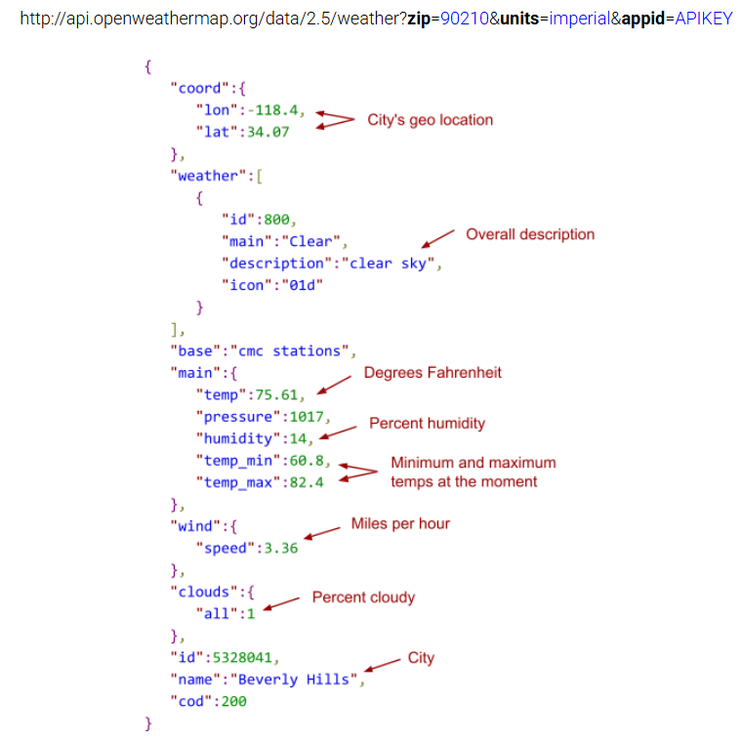
Example
Notes:
Here, the example shows a JSON response from OpenWeatherMap for ZIP code 90210. It includes the city's geo-location, weather description, temperature in Fahrenheit, humidity, wind speed, cloudiness, and the city name. By using parameters like zip, units, and appid, developers can easily retrieve detailed weather data in a structured format.

Slide 8
Cross-Origin Requests
Calling third-party web APIs from a browser requires cross-origin HTTP requests, as the API is hosted on a different server.
CORS (Cross-Origin Resource Sharing) specifies how browsers and servers should handle cross-origin requests.
JSONP (JSON with Padding) bypasses cross-origin restrictions by dynamically injecting <script> elements, which aren't subject to these restrictions.
Notes:
To start, cross-origin requests are needed when calling third-party web APIs from a browser, as the API is on a different server. CORS, or Cross-Origin Resource Sharing, defines how browsers and servers handle these requests. Alternatively, JSONP bypasses restrictions by injecting script elements, enabling data retrieval from external sources without CORS.

Slide 9
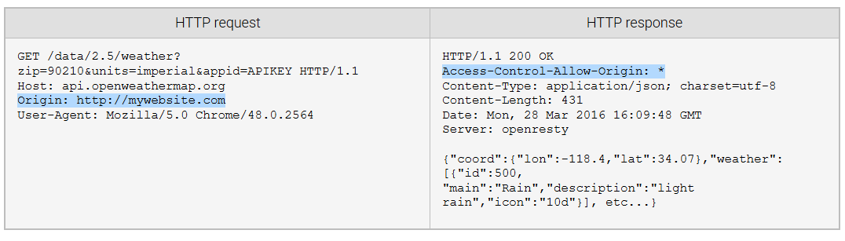
Example
Notes:
In this example, the browser sends an HTTP request to OpenWeatherMap's API with an origin header. The server responds with Access-Control-Allow-Origin set to a wildcard, allowing any origin to access the data. This CORS header enables the browser to receive the JSON response containing weather details, demonstrating how cross-origin requests are handled.

Slide 10
Calling the Weather API from JavaScript
The Weather API can be called from JavaScript using the XMLHttpRequest object for asynchronous HTTP requests.
OpenWeatherMap supports CORS, allowing API requests from any origin.
To retrieve weather data using JavaScript, replace the "APIKEY" placeholder with a valid API key.
Notes:
To continue, the Weather API can be accessed using JavaScript's XMLHttpRequest object for asynchronous HTTP requests. OpenWeatherMap supports CORS, allowing requests from any origin. Finally, to retrieve weather data, remember to replace the APIKEY placeholder with a valid API key. This setup enables dynamic weather updates in web applications.

Slide 11
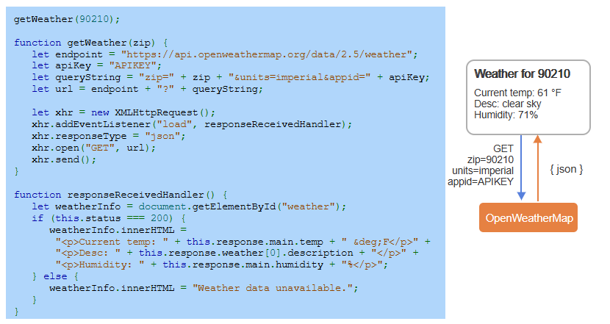
Example
Notes:
Here, the JavaScript function get Weather makes an API call to Open Weather Map using XML Http Request. It retrieves weather data for a given ZIP code and displays the temperature, description, and humidity on the webpage. Remember to replace the APIKEY placeholder with a valid key. This example demonstrates how to integrate real-time weather data using JavaScript.

